Slide 1
Home Brew
Group 4 - 3CSB: Bonsol, Bravo, Florentino, Gener, Kong
Coffee? Tea? Juice? We have the Recipe for you

Slide 2
Problem Statement
People are getting tired of the usual drinks like coke, instant coffee, powdered juice but they don’t have the time, money or necessary ingredients to be able to make a good drink for themselves.
Some people may feel like they lack a repertoire of beverages in their lifestyle, or perhaps make new beverages on a whim or as a hobby.
There is limited access to freshly prepared flavored drinks as visiting restaurants and cafes may be time-consuming and unsafe especially during a pandemic

Slide 3
Objectives
To provide the users recipes for drinks that only uses ingredients usually found in homes
To provide users recipes that calls for ingredients at an affordable price and searches less expensive alternatives for different ingredients
To make an application usable by a wide range of people ranging from children to the elderly that finds recipes for great drinks
To create a collection of beverage recipes that is easily accessible for each user where they could save their favorite recipes to be prepared whenever they like

Slide 4
Mock-up Prototype
Home Brew
50%| | 16:11
Username
******
Login
Sign Up
Login Page

Slide 5
Mock-up Prototype
Home Brew
Create a Profile
50%| | 16:11
Username
E-mail
Password
Confirm Password
Create Profile
Back
Sign Up Page

Slide 6

Mock-up Prototype
Home Brew
Featured Drinks
Popular Now
Recent Searches
My Favorites
Main Page
User Home Page

Slide 7

Mock-up Prototype
Home Brew
Featured Drinks
Popular Now
Recent Searches
My Favorites
Main Page
User Home Page

Slide 8
Mock-up Prototype
Home Brew
Featured Drinks
Popular Now
Recent Searches
img
img
img
Espresso
Milktea
Latte
img
img
img
Espresso
Milktea
Latte
Main Page
Expanded Home Page

Slide 9
Mock-up Prototype
Home Brew
Featured Drinks
Popular Now
Recent Searches
img
img
img
Espresso
Milktea
Latte
img
img
img
Espresso
Milktea
Latte
Main Page
Expanded Home Page

Slide 10

Mock-up Prototype
Hello,
User
Featured Drinks
Home
Popular Now
Search
Recent Searches
Favorites
Settings
My Favorites
Logout
50%| | 16:11
img
img
img
Juice 1
Some Tea
Latte
img
img
img
User Sidebar

Slide 11
Mock-up Prototype
Home Brew
My Favorites
img
img
img
img
Juice 1
Some Tea
Latte
Shake
img
img
img
img
Espresso
Depresso
Milktea
Frappe
img
img
img
img
Drink1
Drink2
Drink3
Drink4
Favorites Page

Slide 12
Mock-up Prototype
Home Brew
Brightness
Font Size
Notification
Account Settings
Help and support
Donate to us
About
Settings Page

Slide 13

Mock-up Prototype
Home Brew
Home Brew
Search by name
or
Search by Category
Coffee
Ice Blended
Tea
Frappe
Search Page

Slide 14
Mock-up Prototype
Home Brew
Home Brew
Search by name
or
Search by Category
Select your choice:
Hot
Cold
Coffee
Ice Blended
CANCEL
OK
Tea
Frappe
Search Page II

Slide 15

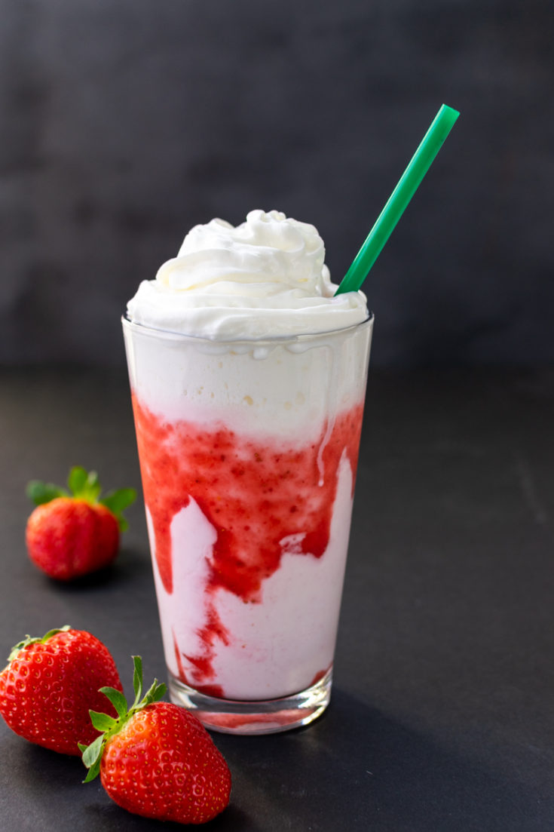


Mock-up Prototype
Home Brew
Results:
Espresso
Depresso
Salted Caramel Co...
Frappuccino
Green Tea
Waldo’s Drink
Search Results Page

Slide 16
Mock-up Prototype
50%| | 16:11
Salted Caramel Coffee
Salted Caramel Coffee
5 min.
Ingredients:
+ Ground Coffee
+ Sugar
+ Salt
+ Milk
Recipe:
1: Brew the coffee
2: Add sugar and milk
3: Add a pinch of salt
User Recipe Page

Slide 17
Mock-up Prototype
Home Brew
Featured Drinks
Recent Searches
My Favorites
Popular Now
Main Page
Admin Home Page

Slide 18

Mock-up Prototype
Hello,
Admin
Featured Drinks
Home
Popular Now
Search
Recent Searches
Favorites
Settings
My Favorites
Add Recipe
Logout
50%| | 16:11
img
img
img
Juice 1
Some Tea
Latte
img
img
img
Admin Sidebar

Slide 19
Mock-up Prototype
50%| | 16:11
Recipe Name
Recipe Name
Prep Time
Ingredients:
+ ...
Recipe:
1: ...
Delete
Save
Admin Add/Edit Recipe

Slide 20
Mock-up Prototype
50%| | 16:11
Recipe Name
Delete Recipe
Are you sure you want to delete this recipe?
Recipe Name
NO
YES
Prep Time
Ingredients:
+ ...
Recipe:
1: ...
Delete
Save
Admin Delete Recipe

Slide 21
Mock-up Prototype
50%| | 16:11
Recipe Name
Tags
Coffee
Ice Blended
Recipe Name
Tea
Prep Time
Ingredients:
+ ...
Recipe:
1: ...
Frappe
Delete
Save
Admin Save Recipe I

Slide 22
Mock-up Prototype
50%| | 16:11
Recipe Name
Select subcategory:
Hot
Cold
Recipe Name
Prep Time
Ingredients:
+ ...
Recipe:
1: ...
CANCEL
OK
Delete
Save
Admin Save Recipe II

Slide 23
Mock-up Prototype
50%| | 16:11
Salted Caramel Coffee
Salted Caramel Coffee
5 min.
Ingredients:
+ Ground Coffee
+ Sugar
+ Salt
+ Milk
Recipe:
1: Brew the coffee
2: Add sugar and milk
3: Add a pinch of salt
Edit
Admin Recipe Page

Slide 24
UI & Logic
ColorPrimary -
PrimaryLight -
PrimaryDark -
#5bc7aa
#8ffadc
#1f967b

Slide 25
UI & Logic
Login
Enters the application
Create Profile
Creates a personalized record of the user
Hot and Cold Radio Button
Is the optimal / preferred temperature of the drink.
Sweetness Dropdown List and Button
Used to specify how the sugar content in relation with the other ingredients.
Other Flavors Radio Button
Used to include exclusively an additional flavor of the recipe.
Base Radio Button
Used to specify what kind of base the drink has whether it is tea leaves, coffee beans or fruit juice.
Back Button

Slide 26
UI & Logic
Home
Takes you to the Main Page.
Search
Takes you to the Search Page.
Favourites
Takes you to the Favourites Page.
Settings
Takes you to the Setting Page.
Log Out
Logs out of your account.

Slide 27
UI & Logic
Simple Recipes Website
https://www.simplyrecipes.com/recipes/course/drink/
Youtube Channel Epicurious
https://www.youtube.com/user/epicuriousdotcom/videos
Other sites that show recipes for beverages
https://www.thespruceeats.com/best-coffee-recipes-4796504
https://www.tasteofhome.com/collection/tea-recipes-you-havent-made-yet/
https://juicerecipes.com/

Slide 28
Others:
Target Customers
Students, work-from-home employees, or household workers
For people who want to treat themselves but lack the money
For people who like cooking / making a good drink

Slide 29
Home Brew
Group 4 - 3CSB: Bonsol, Bravo, Florentino, Gener, Kong
Thank you!

